Slide 1
Employee Data Analysis using Excel
STUDENT NAME: MAHAK . A
REGISTER NO: 122202251, 90359C489CA28C295B948A0B439061EF
DEPARTMENT: B.COM (Corporate Secretaryship)
COLLEGE: ANNA ADARSH COLLEGE FOR WOMEN

Slide 2
PROJECT TITLE
Employee Performance Analysis using Excel

Slide 3



AGENDA
Problem Statement
Project Overview
End Users
Our Solution and Proposition
Dataset Description
Modelling Approach
Results and Discussion
Conclusion
3/21/2024 Annual Review

Slide 4

PROBLEM STATEMENT
The purpose of employee data analysis is to gain insights into the workforce , identify trends, and make data-driven decisions to improve organizational efficiency, employee satisfaction, and overall business performance.
By analyzing this data, companies can optimize their HR
practices, enhance employee experience, and address
potential issues before they escalate.

Slide 5

PROJECT OVERVIEW
Employee data analysis is the process of collecting and examining workforce-related data to gain insights that inform HR decisions and improve organizational performance. By analyzing data on employee demographics, performance, engagement, and retention, organizations can identify trends, optimize HR practices, and make data-driven decisions that enhance employee satisfaction and efficiency. This approach helps in predicting future workforce needs, reducing turnover, and aligning HR strategies with business goals.

Slide 6
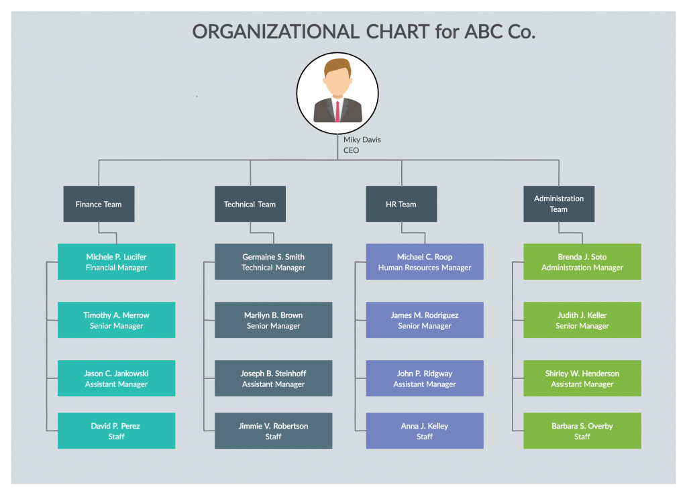

WHO ARE THE END USERS?

Slide 7
OUR SOLUTION AND ITS VALUE PROPOSITION
CONDITIONAL FORMATTING : Conditional formatting is a feature that automatically applies formatting to cells based on specific criteria or conditions.
FILTER: A filter is a tool that allows you to display only the data in a spreadsheet that meets specific criteria, hiding the rest and to remove the missing values .
FORMULA : To Calculate the performance level of an Employee
PIVOT : To get summary
GRAPH: A graph (or chart) is a visual representation of data that helps illustrate patterns, trends, and relationships within a dataset.

Slide 8
Dataset Description
EMPLOYEE DATA SET : KAGGLE
FEATURES :
Employee ID: Unique identifier for each employee in the organization.(numerical )
First Name: The first name of the employee.(text)
Last Name: The last name of the employee.(text)
Employee Type: The type of employment the employee has (e.g., Full-time, Part-time, Contract) (text)
Performance Level : A level indicating the employee's performance level (e.g., very high, high, med,low) (text)
Gender: A code representing the gender of the employee (e.g., M for Male, F for Female, N for Non-binary).(text)
Current Employee Rating: The current rating or evaluation of the employee's overall performance.(numerical)

Slide 9

THE "WOW" IN OUR SOLUTION
PERFORMANCE LEVEL =IFS(Z8>=5,”VERY HIGH”, Z8>=4,”HIGH”, Z8>=3,”MED”, TRUE, “LOW”)
3/21/2024 Annual Review
9

Slide 10
MODELLING
DATA COLLECTION : Gather data from HR systems performance review or other sources. Include relevant field such as employee ID name business unit performance core attendance and other performance metrics
DATA CLEANING : Remove duplicates and correct errors. Handle missing values (eg: imputation or removing rows with blanks )
TECHNIQUES: Use conditional formatting to highlight anomalies or key metrics . Apply Filter to focus on specific subsets of data . Uutilise formulas for calculations like average performance course or total sales
10

Slide 11
MODELLING
RESULTS : Analyse performance trends, identify top performance, and areas needing improvement. Summarise key insights from the data, such as average performance scores by business unit.
PIVOT TABLE : create a pivot table to summarise data by categories such as business unit or performance core. Drag and drop fields into rows, columns and values to analyse data dynamically.
CHART\ GRAPH : Insert charts (eg: bar, line or pie charts ) to visualise performance data. Use charts to present trends, comparisons and distribution effectively.
11

Slide 12
RESULTS
12

Slide 13
RESULTS
DIFFERENT SECTORS
MED
HIGH
13

Slide 14

conclusion
Summary of Findings: Provide a brief overview of the general performance landscape.Strategic Decisions: Offer final recommendations based on the analysis to help management make informed decisions regarding promotions, bonuses, or restructuring.
Using Excel for employee performance analysis allows for detailed data handling and visualization, making it a powerful tool for making informed HR decisions.

